Slide 1
Phase I Text to Image Generation
- Aishwarya, Aveek, Harshita
Notes:
Hello Everyone, Today we are giving phase I presentation of our project – Text to Image Translation.

Slide 2
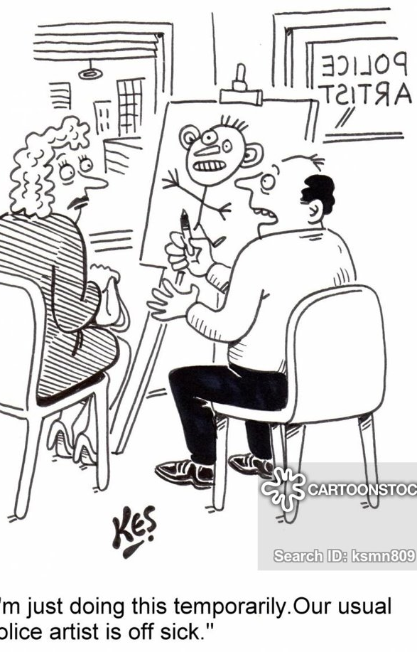
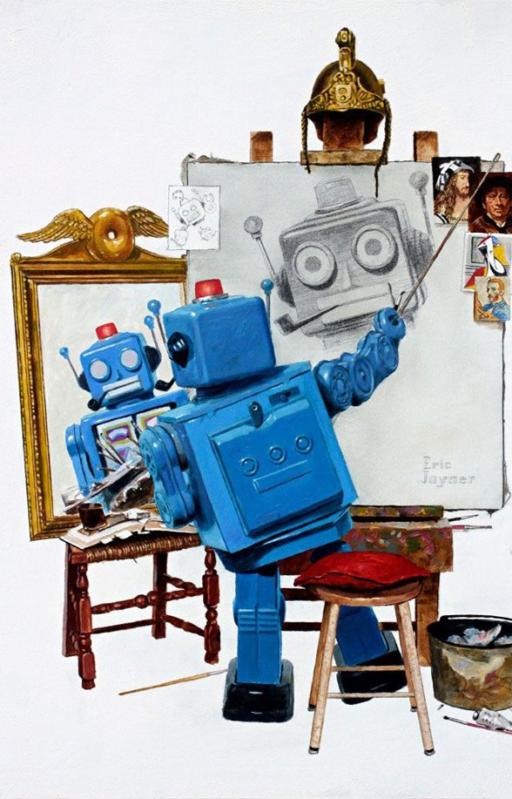
Motivation
What if a computer can generate realistic images in few seconds by just giving simple textual descriptions ?
Notes:
Converting natural language text descriptions into images is an amazing demonstration of Deep Learning and it involves technological advancements in both Natural Language Processing and Computer Vision. Through this project we want to explore architectures that could help us achieve our task of generating images from given text descriptions. Generating photo-realistic images from text has tremendous applications in photo-editing, art generation etc.

Slide 3
Objective / Goals
Algorithmic development
Computational limitation
Visual realism
Semantic consistency
Single domain learnings
Application on a wider dataset, e.g., MS-Coco
Low resolution output (64x64)
Expand domain
Improve resolution
Platform for end - user
End-to-end flow
REST service for neural model
Notes:
Goals of this project is to develop a text to image system focusing on algorithmic development, computational limitation, visual realism and semantic consistency. We have divided the task into low, medium, and high risk.
In low-risk, we build a system around a limited domain (CUB dataset) and generate low resolution images. The goal during this phase is to also build the end-to-end pipeline, which could then be used in future phases to improve on performance.
We would like to improve on the resolution of our output images in medium risk. On achieving a better resolution goal, we would also like to expand our domain by fusing more than one category dataset.
Finally, we would like to extend our system to a much wider dataset like the MS-COCO, which would involve elevated risk due to the nature of the constituting data. In the final phase of the project, we also look forward to building a robust platform that can consume our API service and act as an interface for end-users.

Slide 4
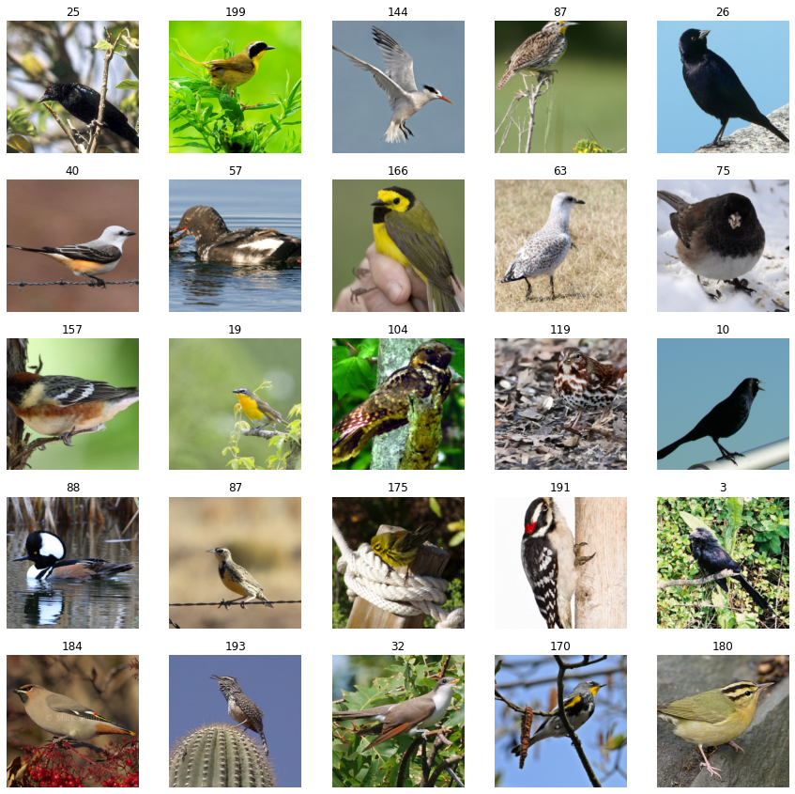
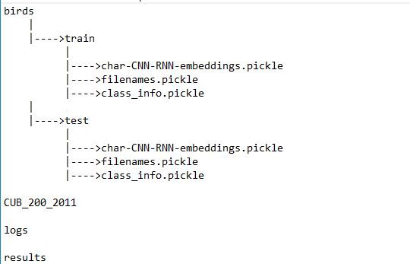
Dataset
Caltech-UCSD Birds 200 (CUB) contains 200 bird species with 11,788 images.
Captions for each image is provided in 10 different ways with Birds dataset
Random Images from CUB dataset
Notes:
We are training our model on Caltech Birds dataset . CUB contains 200 bird species with 11,788 images.
Along with the images, we are provided with 10 captions for each image.
Our data is organized as below.

Slide 5
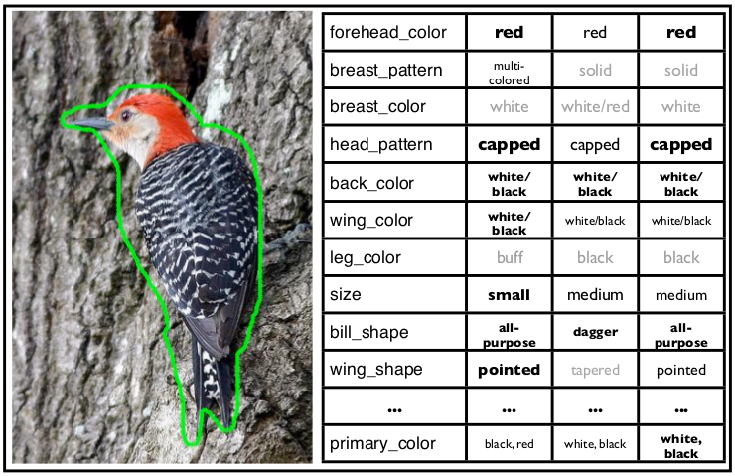
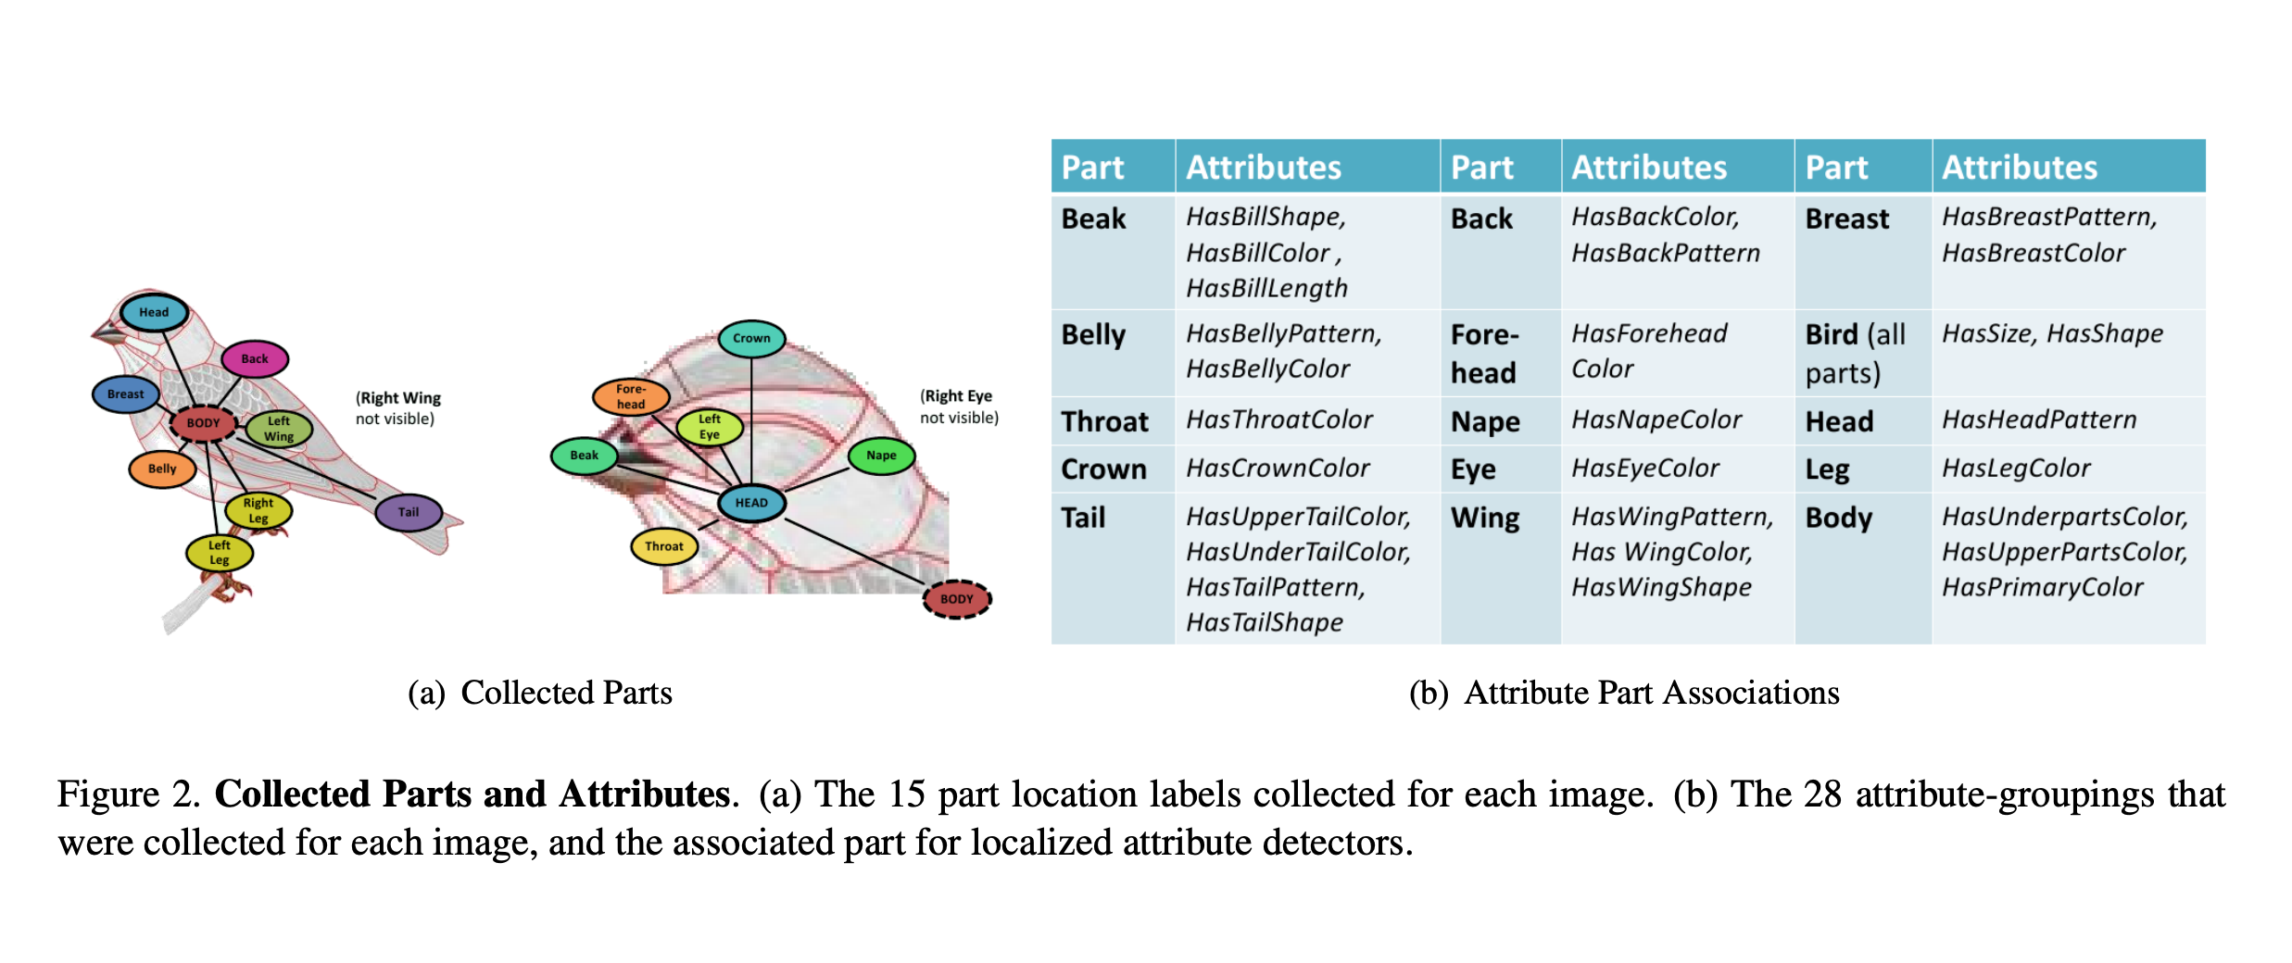
Dataset
Notes:
Diving deeper , CUB-200 dataset presents annotation of bounding boxes and a rough bird segmentation in order to identify the outline of the bird. We also have a set of attribute labels depicting various features of the bird. Each image has a table of attributes – here, only 11 out of 25 attributes are shown.
These annotations are particularly helpful in our case because accurately classifying more than a handful of birds is something only a small proportion of people can do without access to a field guide – thus an area where visual recognition system is useful.
Since 80% of birds in this dataset have object-image size ratios of less than 0.5, as a pre-processing step, we crop all images to ensure that bounding boxes of birds have greater-than- 3/4th object-image size ratios.

Slide 6
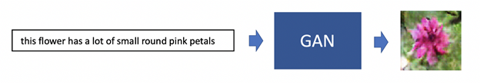
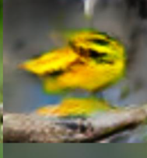
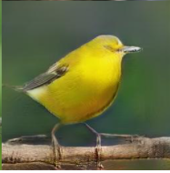
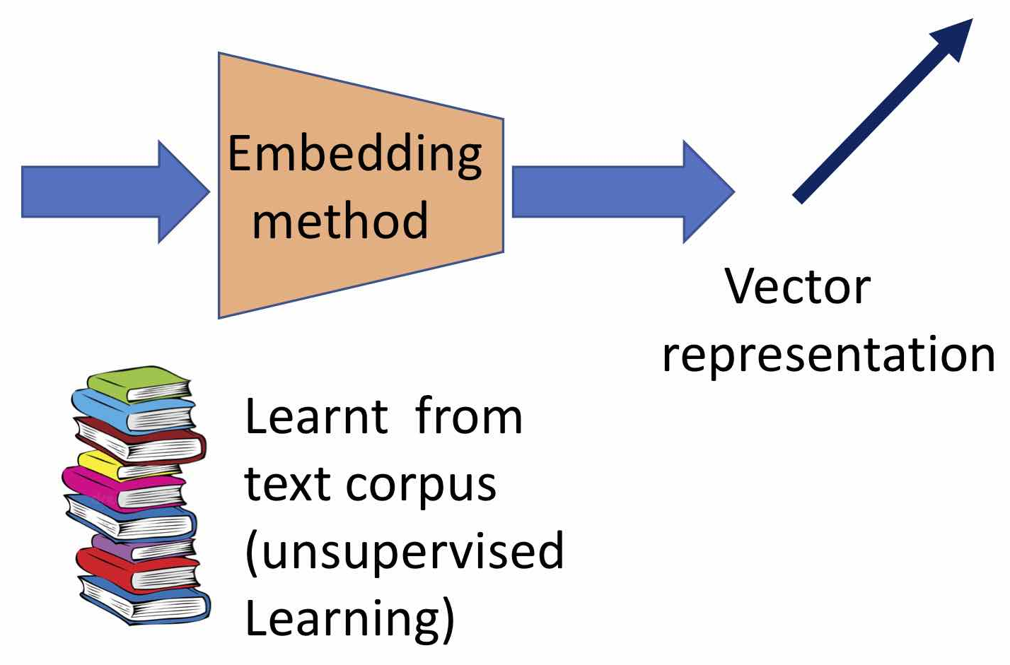
Methodology
March 2nd,2021
Stage 1
Stage 2
Pre-processing
Small yellow bird with a black crown and a short pointed beak
Low Risk
Medium Risk
Text Description
Notes:
Through this project, we aim to implement a Stacked Generative Adversarial Network (GAN) architecture in order to solve this problem of text to image generation. Our implementation of Stacked GANs breaks the overall process into two stages.
Stage-I sketches the primitive shape and basic colors of the object conditioned on the given text description and draws the background layout yielding a low-resolution image.
Whereas Stage-II GAN: corrects defects in the low-resolution image from Stage-I and completes details of the object by reading the text description again, producing a high-resolution photo-realistic image.
At present, we are in the process of training our stage-1 GAN to generate the low-resolution image.

Slide 7
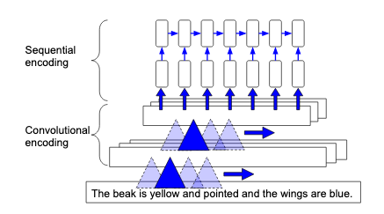
Text Encoding
Combines benefits of CNN & RNN
CNN – low level temporal features
RNN – temporal structure, not strictly delineated by word boundaries
Trained at character-level processing
Convolutional - Recurrent Neural Nets (CNN-RNN)
Notes:
The first step in the entire flow is to encode our description which is present in textual form. A key challenge in image understanding is to correctly relate natural language concepts to the visual content of images and hence we use visual-semantic embeddings. In the context of image generation from text, we use a character level convolutional-recurrent neural net model (also called char-CNN-RNN), trained on the birds captions data. The hybrid CNN-RNN model combines the benefits of both convolutional as well as recurrent networks.
The convolutional-only text models lack a strong temporal dependency along the input text sequence. In the hybrid approach, CNN learns the low-level temporal features whereas the RNN focuses on the temporal structure which is not strictly delineated by the word/character boundaries.
The non-uniform text sequence length is handled using zero-padding, and the descriptions are embedded to length of 1024 in this case.

Slide 8
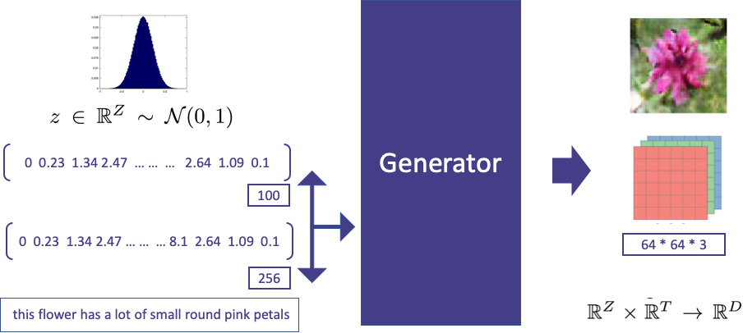
Stage-I Generator
100
1024
Small yellow bird with a black crown and a short-pointed beak
Notes:
Moving on to the Generator. In the GAN implementation, the generator is one of the 2 networks that contest against each other. In essence, the generator part of the GAN learns to create fake data by incorporating feedback from the discriminator network. The objective for the generator is to learn to make the discriminator classify its output as real.
In its native form, the generator takes a random noise as input and transforms it into meaningful output. The noise allows the GAN to produce a wide variety of data. Here in our case, instead of only noise as input to the Generator, the transformed text embeddings concatenated with the noise vector is supplied as input to the Generator. Specifically, our text embedding is now a 1024-dimensional embedding and the noise is a 100-dimensional vector sampled from a normal distribution. This formulation helps our Generator to generate images aligned with input description, that is of birds, instead of generating random images. The output images are of the dimension 64x64x3 (RGB channels).

Slide 9
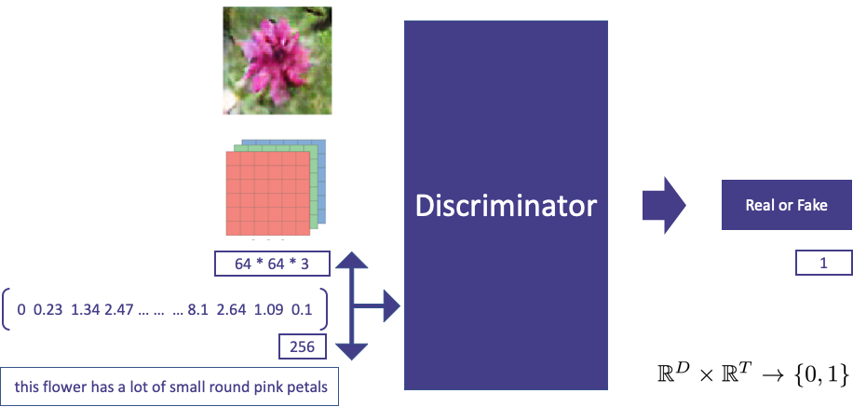
Stage-I Discriminator
1 or 0
1024
Small yellow bird with a black crown and a short-pointed beak
Notes:
Let’s now look at the second network that competes in our game – the discriminator. In essence, the Discriminator is a simple classifier that tries to distinguish the real data from the data created by the generator. Though it can use any type of architecture, we stick to a deep convolutional network given the complex features. Though usually the Discriminator uses only the real and generated images as input, we also provide the text embeddings paired with the image. The Discriminator’s responsibility then along with predicting whether given image is real or fake , is also to predicts the likelihood of whether the given image and text align with each other. This formulation force Generator to not only generate images which looks real but also to generate images which are aligned with input textual description.

Slide 10
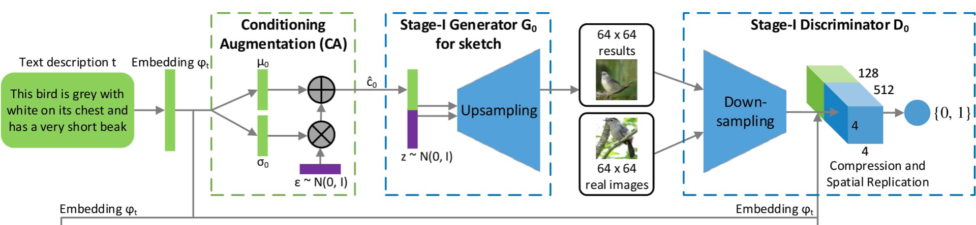
Stage-I GAN
Fully connected layer with one node is used to produce the decision score.
Text embedding is fed into a fully connected layer to generate µ and σ
c is sampled from the Gaussian distribution using c = µ+ (σ .* gaussian noise)
c is concatenated with a n dimensional noise vector to generate image by a series of up-sampling blocks.
Notes:
Next, Bringing these components together we form a network like this.
As we saw before, the process starts with transforming text into embeddings and then combining them with the random normal noise to feed into the Stage-1 G through gaussian conditioning which will generate a low resolution 64x64 RGB image. This image might have representations of low-level features of input like shape, color, segments of areas, etc. Generative models in the GAN are required to up-sample the input data in order to generate output images, but since up-sampling directly can lead to training instability, we combine it with convolutional layers in our implementation.
Our discriminator uses down-sampling and concatenates feature maps to the text embeddings using compression and spatial replication before moving to the classification. This ensures image and text description alignment. In a way, the discriminator connects to 2 loss functions. The discriminator loss penalizes the discriminator for misclassifying a real instance as fake or a fake instance as real. The discriminator updates its weights through backpropagation from the discriminator loss through the discriminator network. The discriminator loss is also backpropagated through the generator network to obtain gradients which in turn change the generator weights.

Slide 11
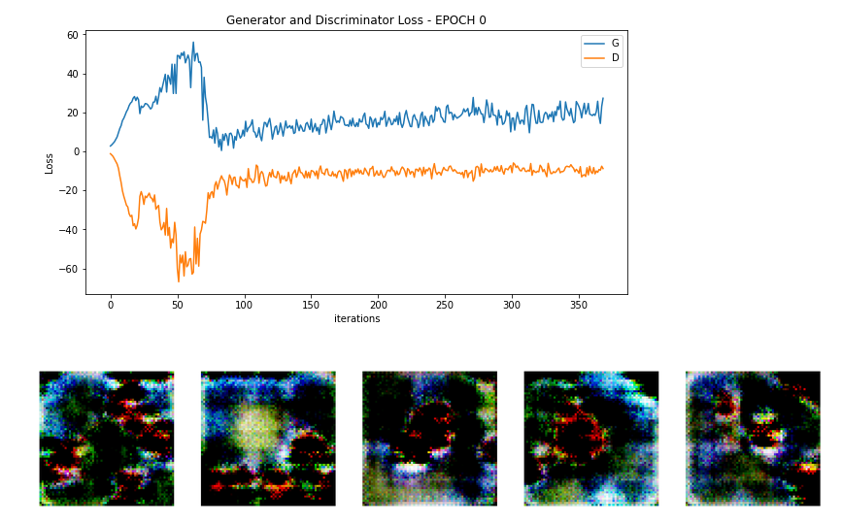
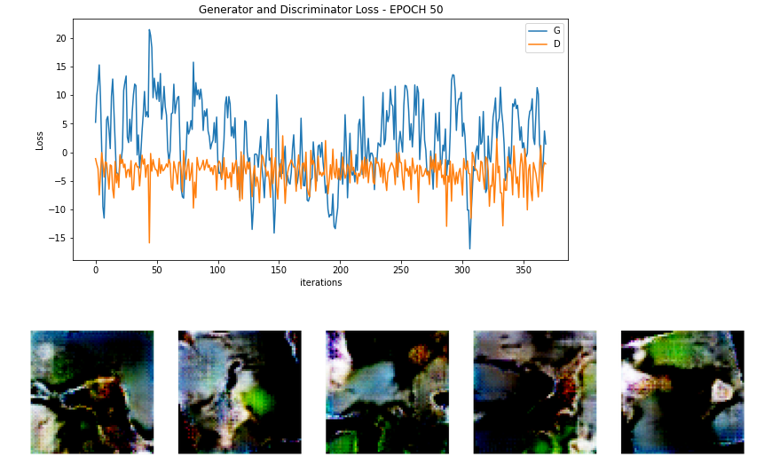
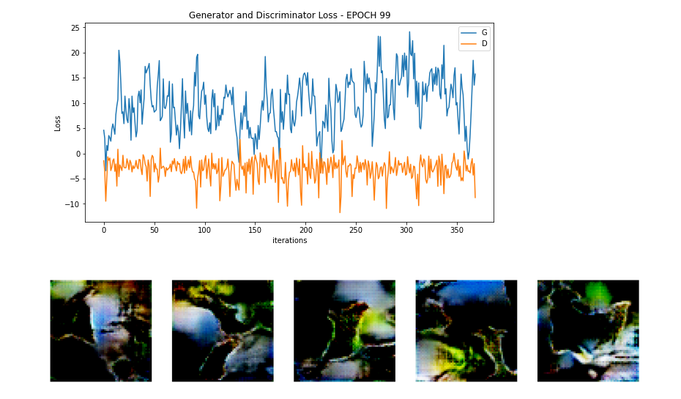
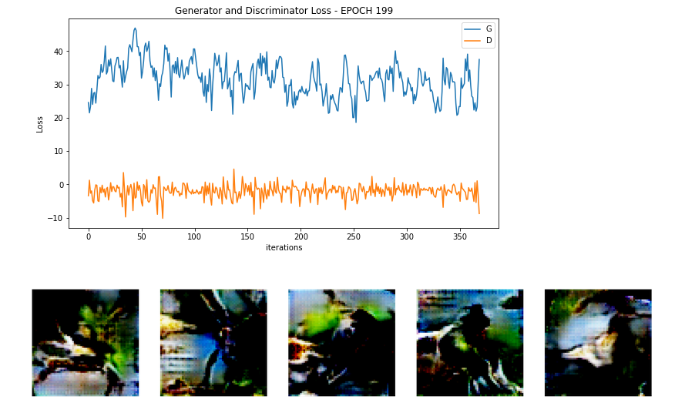
Stage-I Training
Notes:
Now, taking a look at our Stage I training process. We train our network for 1000 epochs.
Here we are showing 4 snapshots of Epoch 1, 50,100,200 and the generator discriminator loss as well. Roughly the idea is to bring both Generator and Discriminator loss closer to 0.
As it can be seen the initial epocs shows unclear random color patches as image which can be seen getting improved later with epocs. In the 200th epoch we see The images are way better than initial epocs with some borders and outlines depicting bird like features, but not perfect birds.

Slide 12
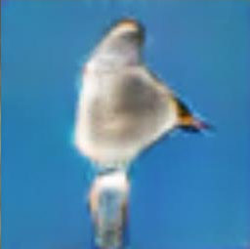
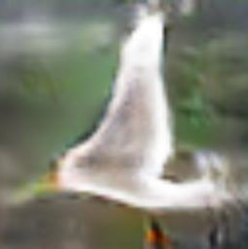
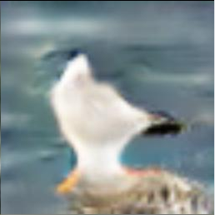
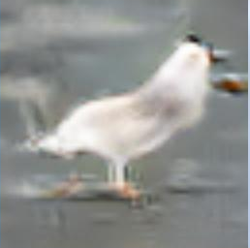
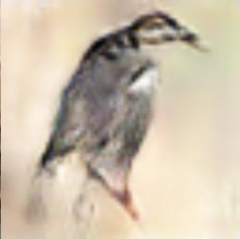
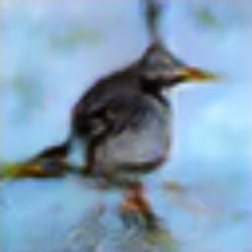
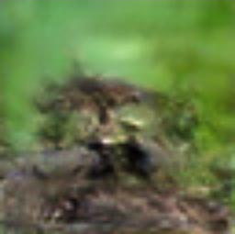
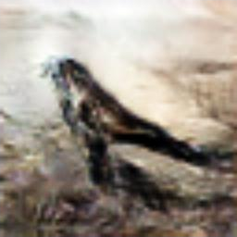
Results
Text Description | Sample 1 | Sample 2 | Sample 3 | Sample 4
A white bird with a black crown and yellow beak
Bird is white, black and brown in color with a brown beak
Notes:
In this slide, we present the outcome of our phase I training, In the left we can see the text description given and in right we have 4 sample images for each of these text description.
If we look at some of these images, for example in the first example – we see roughly some white birds with features like beaks and more. Though the images are not clear, that will be the goal of the stage 2 GAN to handle. Even in the second example, we can see roughly decent images of a black and brown bird.
This was our low risk idea and the model did generate low resolution 64*64 output from text description.

Slide 13
Conclusion
Successfully established end-to-end pipeline to generate low resolution images from textual input.
The primitive shape and basic colors of the object (conditioned on the given text description) and the background layout from a random noise vector are drawn, yielding a low-resolution image.
Next steps is to train stage II GAN to generate high resolution images using these low-resolution images from stage II
Notes:
At last, we would like to conclude our phase I and summarize what we have achieved here:
Successfully established end-to-end pipeline to generate low resolution images from textual input.
The primitive shape and basic colors of the object (conditioned on the given text description) and the background layout from a random noise vector are drawn, yielding a low-resolution image.
We are now ready for our phase II, containing our medium risk and high-risk objective of generating high resolution images and expand our domain by fusing more than one category dataset. And Finally, building a robust platform that can consume our API service and act as an interface for end-users.
Thank you.

